Slide 1

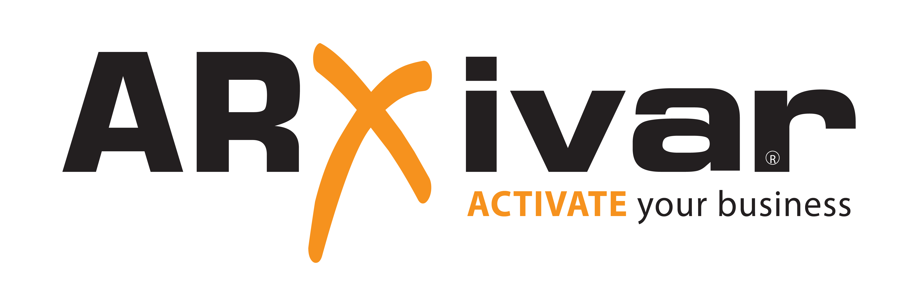

Slide 2




IaC con Terraform… e Azure DevOps!
Riccardo Cappello
Senior Consultant CDCT – DI @
Microsoft Azure MVP | Intel Software Innovator | rcappello@outlook.com

Slide 3

Who I am
@rcappello​
rcappello​
RICCARDO CAPPELLO
Riccardo Cappello​

Slide 4


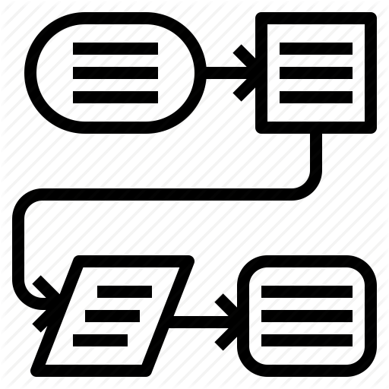



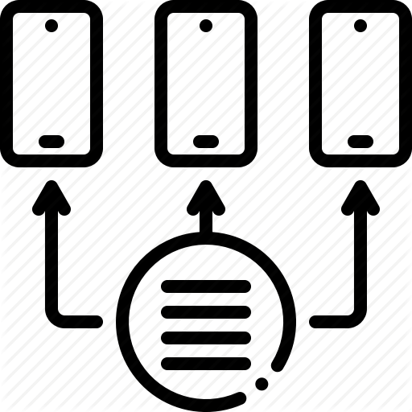
What is IaC
Infrastructure as Code (IaC) is a method to provision and manage IT infrastructure through the use of source code, rather than through standard operating procedures and manual processes.
Classic Approach
IaC Approach
Request of the Infrastructure
Review the Infra Delivery Process
Take in charge the request
Automate Infrastructure Delivery
Point and click provisioning
Self provisioning

Slide 5
Why IaC?
Cloud and Virtual Environment are API Driven
New generation infrastructure is more dynamic
Key Benefit
Infrastructure standardization
Self Provisioning
Infrastructure Versioning
Centralized Policy Governance
Minimization of Risks
Documented Infrastructure
Infrastructure Automation
Enable NetOps through SDN
Enable DevOps integration
Enable SecOps
Increase productivity

Slide 6



IaC as standard for Infrastructure Cloud Delivery
Professional
Quality of Delivery
Innovation
Formal definition of Delivered Infrastructure
Deliverable
Infrastructure versioning and lifecycle
Reusable artefact
Increase quality of Infrastructure delivered
Enable automation
Enable DevOps/SecOps/NetOps
Enable Policy integration and automation
Enable Self Provisioning

Slide 7
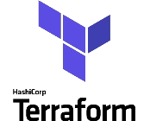
Terraform
https://terraform.io

Slide 8
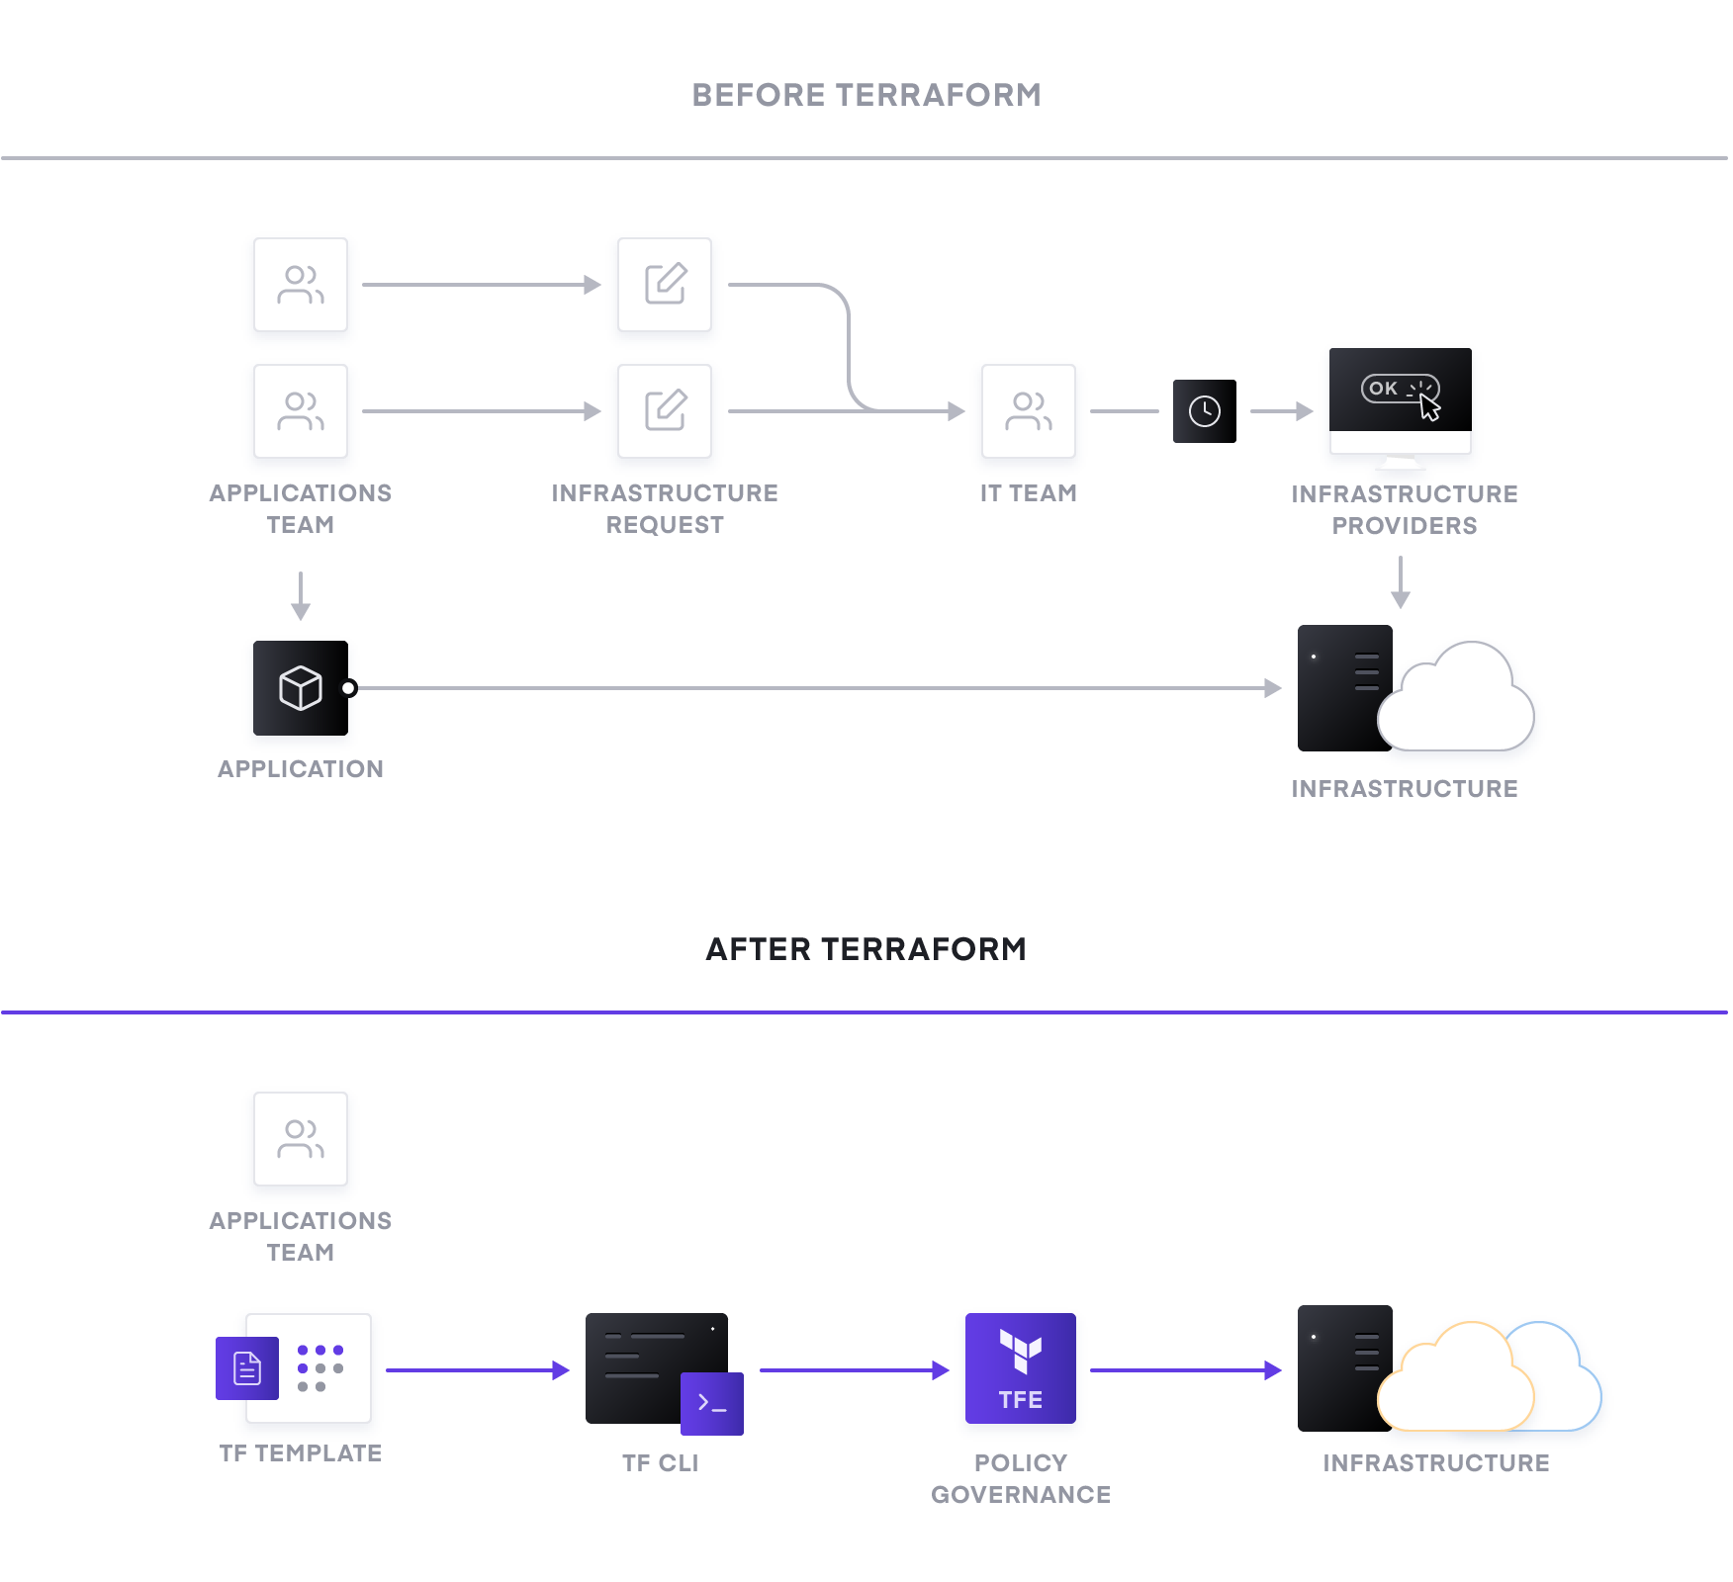
IaC with Terraform
IaC with Terraform
Manual provisioning by IT Team
No Infrastructure Versioning
Self Provisioning by App Teams
Infrastructure Versioning
Automated Policy Governance

Slide 9
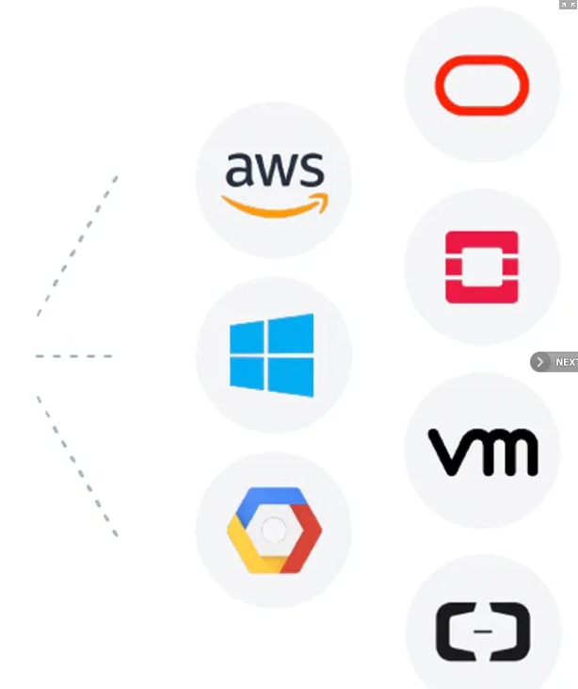

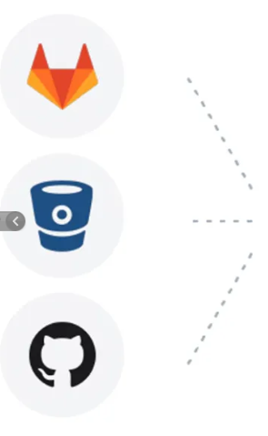


Terraform Basic Concepts
TerraformCore
Module
Infrastructure Code
Providers

Slide 10
Terraform workflow
Apply
Init
Plan
Destroy
Infrastructure Code
CLI
Cloud
Enterprise

Slide 11
DEMO

Slide 12
What is DevOps?
People. Process. Products.
Build& Test
Deploy
DevOps is the union of people, process, and products to enable continuous delivery of value to your end users.
“
Continuous Delivery
Develop
Operate
”
Plan & Track
Monitor & Learn
Notes:
DevOps is the union of people, process and products to enable the continuous delivery of value to your end customers

Slide 13
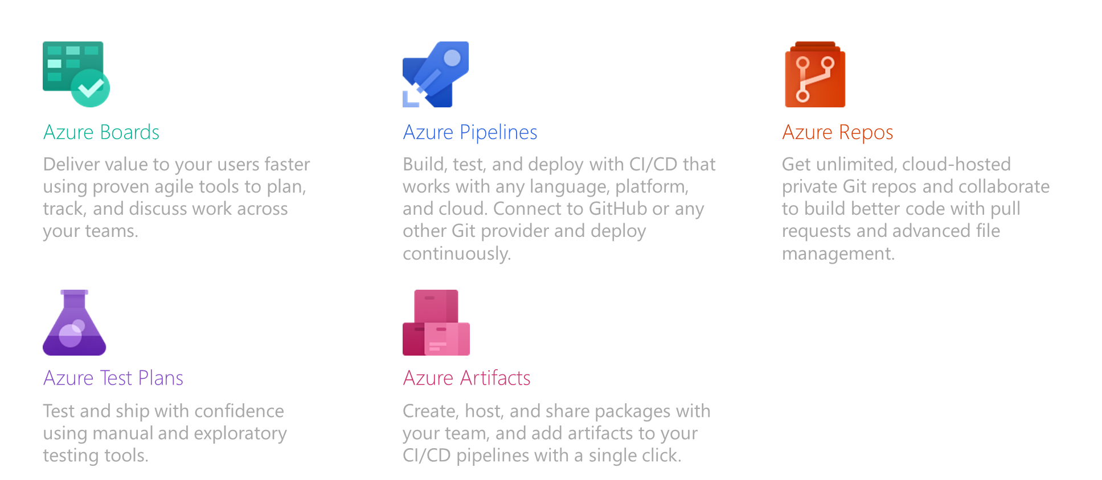
Introducing Azure DevOps

Slide 14
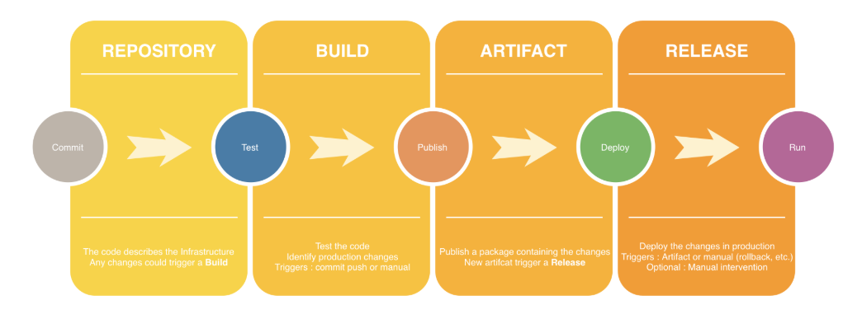
IaC in a CI/CD Pipeline

Slide 15
Build an Approval Workflow for IaC
Commit
Test
Publish
Deploy
Run
Change the Terraform Code and commit to the Repo (or other supported repository)
Run Terraform Init in order to assure that there are no key configuration Issue
Run terraform Plan to verify the differences between the new infrastructure committed in the repository and what is already installed.
Run the terraform Apply in order to deploy the new infrastructure
Access the new infrastructure in order to assure that the all the infrastructure changes requested are correctly implemented.

Slide 16
DEMO

Slide 17
Quote

Slide 18
References
https://www.terraform.io/
https://app.terraform.io/
https://aex.dev.azure.com/app/register

Slide 19

Github.com/rcappello
@rcappello
Riccardo Cappello​
Riccardo Cappello
Senior Consultant CDCT – DI @
Microsoft Azure MVP | Intel Software Innovator | rcappello@outlook.com

